Slide 1
Hydrological Information System
Module - Water Level measurements
Anish
….. Hydro-Informatics Expert
The World Bank

Slide 2
Examples that refer to products are intended for illustrative purposes only, and do not imply an endorsement or recommendation of any particular product

Slide 3
Introduction
Surface Water Level Measurements
In Rivers
Canals
Reservoirs
Gives only Water Levels, no Discharge or Storage
Two categories of water level sensors
Contact and Non-Contact Solutions

Slide 4
Surface Water Level:
Contact
Sensor or other components that are in contact with the water being measured
Susceptible to debris, siltation, vandalism
Includes:
Shaft Encoder/ Stilling Well
Bubbler
Submersible Pressure Transducer
Non- Contact
Sensor components are not in contact with the water being measured
Includes:
Ultrasonic Sensor
Radar

Slide 5
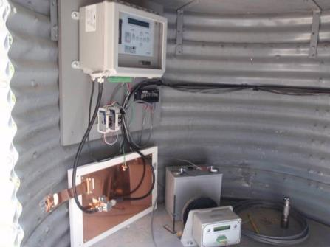
Stilling Well/Shaft Encoder
Concept
Water comes into the stilling well through inlet pipes from the water source
As water level increases and decreases, a float moves up and down with the water level
A tape attached to the float turns a wheel which is connected to the shaft on the encoder. As the wheel turns so does the shaft.
The shaft encoder will convert the shaft rotations to an electronic signal, which will be measured by a data logger
The components of this type of gauge include:
A stilling well
Inlet pipes from the water
Float and weight
Tape
Wheel
Shaft encoder
Shaft Encoder
Float
Water Inlet

Slide 6
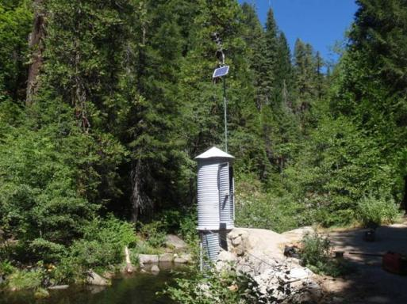
Shaft Encoder Installation and Ideal Location
Installation
The civil works for this type of station is among the most expensive, while the sensor and associated equipment is among the least expensive sensor solutions
Ideal Location
Stable river beds where the channel does not change or migrate away from intakes
Site with minimal sedimentation
Shaft Encoder

Slide 7
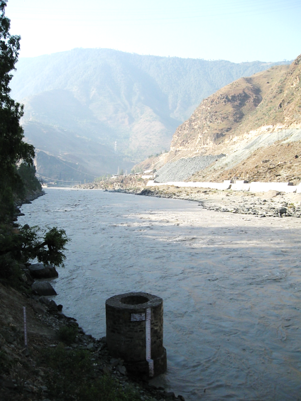
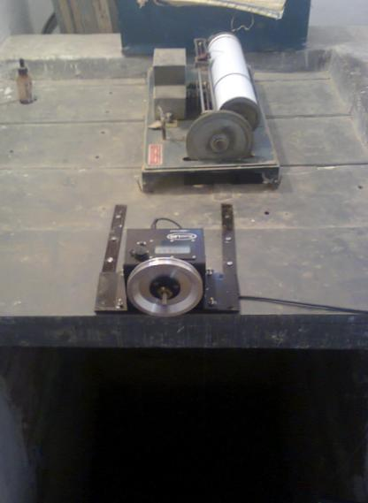
Installation Examples
Shaft Encoder

Slide 8
Shaft Encoder Advantages/Disadvantages
Advantages
Low cost of equipment
No electronic sensor calibration required, but only checked and reset to an outside staff gauge
Disadvantages
Expensive civil works
Requires occasional flushing to remove sediments that may have collected at the bottom of the stilling well. If left unchecked, the sediments could eventually block the inlet/outlet pipes
Shaft Encoder

Slide 9
Bubbler
Concept
The bubbler is a stage measurement device that has a non-submersible sensor
Also known as a gas-purge system the system allows a small quantity of air or inert gas to bleed through a pipe or tubing to an orifice in the stream
The pressure of the gas that displaces the liquid in the orifice is then measured by a pressure transducer located in the gauge house.
Non- Submersible Pressure Transducer
Bubbler

Slide 10
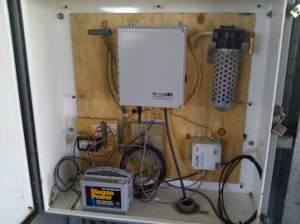
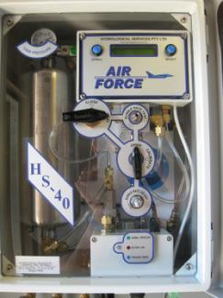
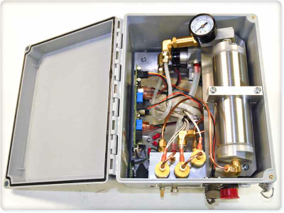
Bubbler Components
Bubbler
Compressor
Orifice Line
Pressure Transducer
Tank
Desiccant
Desiccant
Bubbler
Air Drying System

Slide 11
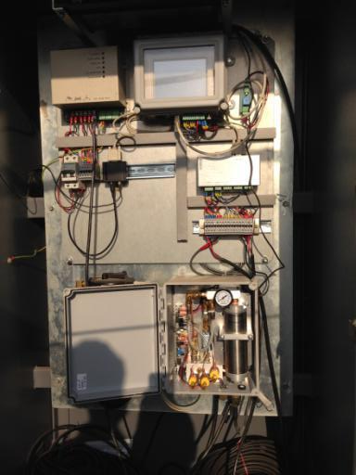
Bubbler Types and Location
Non- continuous
Only turns on at a set time
This allows water to feed back up the orifice line so the line needs to be purged and stabilized
Continuous
Keeps the orifice line under pressure by producing approximately 1 bubble per second
Maharashtra Station
Bubbler
Ideal Location
Open Channels and Reservoirs
Stable river bed where channel does not migrate away from orifice
Not a lot of debris or sedimentation that can cover the orifice inlet
Great option if there is not a bridge or other structure with a direct vertical shot to the water surface.

Slide 12
Bubbler Advantages/Disadvantages
Advantages
It’s a Non-Submersible Pressure Transducer
Elimination of risk or damage of the most expensive part (pressure transducer and compressor)
Orifice line (least expensive component) only part in the water
Install is relatively inexpensive compared to the stilling well for the shaft encoder
Disadvantages
Expensive compared to shaft encoder, ultrasonic sensor and submersible pressure transducer
Not ideal for sites with migrating or shallow channel
Bubbler

Slide 13
Bubbler Advantages/Disadvantages
Advantages
Orifice tubing is inexpensive compared with data cables
Tubing can be run hundreds of feet if necessary, from instrument shelter to the river or stream. This is useful for rivers with widths that vary greatly from the dry to wet seasons.
Disadvantages
More mechanical parts to wear out or malfunction making maintenance more expensive and time consuming than other solutions.
System requires more power to operate compressor. (larger solar panels, batteries, etc.)
Bubbler

Slide 14
Submersible Pressure Transducer
Concept
The pressure exerted on the sensor by the head of water above the sensor is converted to depth.
Components
Submersible pressure transducer
Pipe or plastic conduit
Pressure Transducer

Slide 15
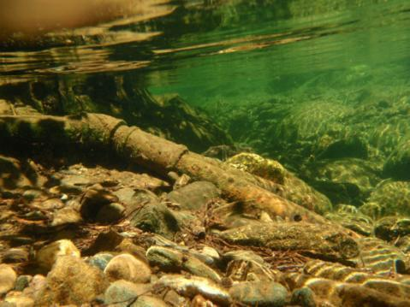
Submersible Pressure Transducer Installation and Setup
Installation
The transducer is installed in a pipe below the minimum water line
Ideal Setup
Protected area with little possibility of debris damage or theft
It is often used to measure water level in wells
Pressure Transducer

Slide 16
Submersible Pressure Transducer Advantages/Disadvantages
Advantages
Relatively easy to install
Sensor only needs to be run down a pipe to some level that is lower than the expected minimum water level
One of the lowest cost sensors (ranging 50,000-80,000 INR)
Disadvantages
Contact solution is in contact with the water where it is vulnerable to debris during high water flows and water pollution
More susceptible to damage caused by vandalism or unintentional damage by animals or people.
Any required calibration must be performed at the factory
Pressure Transducer

Slide 17
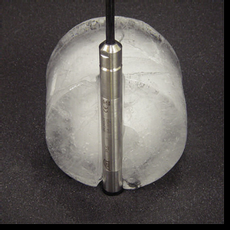
Submersible Pressure Transducer Advantages/Disadvantages
A common disadvantage of pressure transducers was their vulnerability to damage if frozen. Thus they weren’t a good option for high elevation streams that are subject to ice in the winter.
Some new products have now been developed with ceramic sensors that claim to overcome this problem.
Pressure Transducer
If they prove to be reliable even after freezing they would be a good all-round choice for a water-level sensor in most applications (SW and GW)
Cost of cable is a consideration

Slide 18
Non-Contact Solutions:
Ultrasonic Sensor
Radar

Slide 19
Ultrasonic Sensor
Concept
The ultrasonic sensor measures the distance of target objects (water surface) by sending pulsed ultrasound waves at the object and then measuring the time for the sound echo to return. Knowing the speed of sound, the sensor can determine the distance to the object
Speed of sound is affected by temperature so compensation is needed
Ultrasonic Sensor
Components
Sensor
Mounting Platform
Pipe

Slide 20
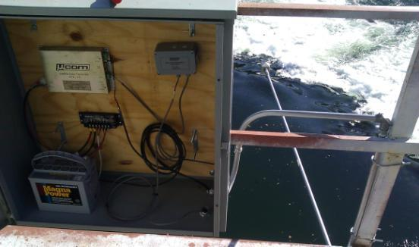
Ultrasonic Sensor Installation and Location
Installation
Requires some sort of bridge or platform to mount the sensor
Sensor must not have any object within the area of signal projection
Should be mounted where it can easily be accessed to repair if necessary
Ultrasonic Sensor
Ultrasonic Sensor
SDI-12 Converter
Data Logger
Signal Projection
Ultrasonic Sensor

Slide 21
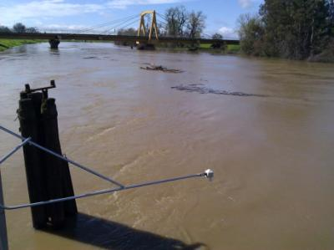
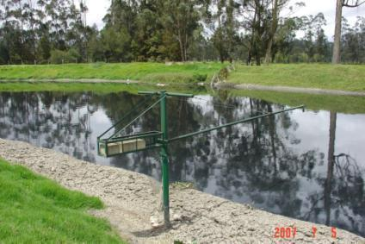
Ultrasonic Sensor Installation and Location
Ideal Location
Need a Bridge or Platform directly over water
Not practical in reservoirs or rivers with shallow slopes
More ideally suited for canals
Measurement distance up to 10m
Ultrasonic Sensor

Slide 22
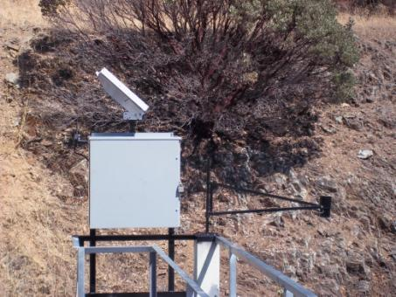
Ultrasonic Sensor Advantages/Disadvantages
Advantages
The advantage to the ultrasonic sensor is the price (around 75,000 INR)
Non-contact method of measurement. The measurement is generally unaffected by the transparency, reflectivity, opacity or color of the target
Ultrasonic Sensor
Disadvantages
Need structure to mount the sensor (bridge railing or boom)
Measurement is not as accurate as other measurement techniques, usually being within .25 to .4 % of the measured distance

Slide 23
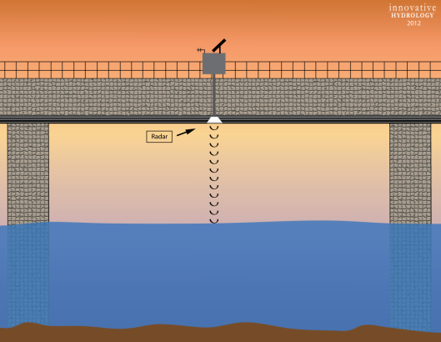
Radar
Concept
The radar works by releasing electromagnetic energy, which is reflected by objects with high dielectric properties (ex: metal and water)
The distance reflected by the microwave energy is determined by the measurement of the time of flight divided by the speed of light.
Various frequencies from 1 Ghz to 30 Ghz are typically used, with the higher the frequency, the more accurate and more costly the device
Components
Radar
Mounting Platform
Pipe
Radar

Slide 24
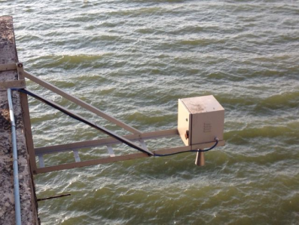
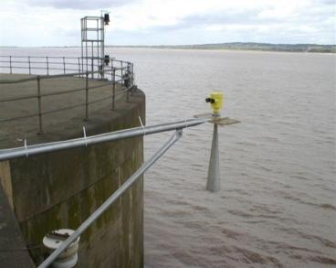
Radar Installation and Location
Installation
Requires some sort of bridge or platform to mount the sensor
Sensor must not have any object within the area of signal projection
Should be mounted where it can easily be accessed to repair if necessary
Ideal Location
Better than ultrasonic sensor for use in moist, vaporous, and dusty environments as well as in applications in which temperatures vary
Requires some structure (bridge railing or boom) to be mounted on
Radar

Slide 25
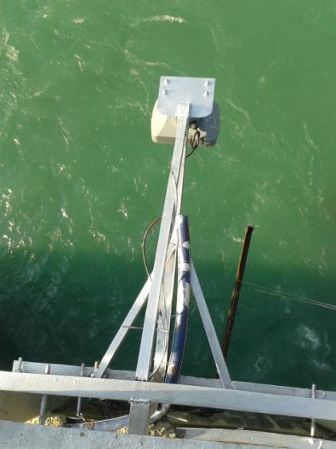
Installation Examples
Radar
Radar Installed at Olinda, BBMB

Slide 26
Radar Advantages/Disadvantages
Advantages
Non-Contact Solution
Radar will penetrate temperature and vapour layers that may cause problems for ultrasonic
Compared to the ultrasonic, radar provides a solution with a greater range of detection between the sensor and the water body (> 30 m)
The radar is more accurate than the ultrasonic sensor
Disadvantages
Need a bridge or platform to mount (same as ultrasonic sensor)
More expensive than ultrasonic sensor
Radar

Slide 27
Instrument Selection Logic
Canal
Reservoir
River
Yes
Stilling Well Present?
Stilling Well Present?
No
No
Stilling Well Present?
Yes
Ultrasonic Level Sensor
or
Shaft Encoder
No
Shaft Recorder
Bridge Present?
Yes
Yes
Possibility of Down looking sensor on DAM?
Water Level Instruments
No
Yes
Bridge, Catwalk Present?
No
No
Yes
Height to water
> 10 M?
Yes
Bubbler
Bubbler
No
Ultrasonic Level Sensor
Radar Level Sensor
Ultrasonic Level Sensor
Shaft Recorder
Bubbler

Slide 28
Instrument Selection Logic
Description | Shaft Encoder | Bubbler | Pressure Transducer | Ultrasonic | Radar
Range | Large | Small | Medium | Medium | Large
Accuracy | Good | Good | Good | Good | Good
Tampering / Sabotage | High | High | Medium | Medium | Medium
Stilling Well | Essential | Not Required | Not Required | Preferable | Not essential
Installation | Simple | Difficult | Simple | Simple | Simple
Maintenance | High | High | None | None | None
Sediment effect | Medium | Very High | Medium | None | None
Cost | Medium | High | Low | Medium | High
Water Level Instruments

Slide 29
Thank You

